Slide 1
1
Causality, symmetry, brain, evolution, DNA,
and a new theory of Physics
Sergio Pissanetzky

Slide 2
2
COMPLEX SYSTEMS WITH A DETAILED DYNAMICS
● adaptive systems that sense the environment.
● computers, robots.
Too detailed for statistical or nonlinear methods.
Propose a new theory built from fundamental principles:
causality, symmetry, least-action, and thermodynamics.

Slide 3
3
CAUSALITY
Build a causal set model of the system:
S = {a, b, c, d, e, f, g, h, i}
ω = {a≺b, a≺c, b≺d, c≺e, c≺g, d≺f, e≺h, g≺i}
Causal sets come from:
● sensors or senses;
● algorithms, computer programs;
● algebraic equations, differential equations.
Causal sets are executable.
● They can control actuators or motor nerves.
Rule of thumb:
If you don’t know how to build the model, write a computer
program and convert it to causal set format.

Slide 4
4
SYMMETRY
Causal sets always have symmetry:
S = {a, b, c, d, e, f, g, h, i}
S = {a, b, d, f, c, e, h, g, i}
S = {a, b, d, f, c, g, i, e, h}
Conservation laws and conserved quantities.
To find them, we need the principle of least-action.
Because conserved quantities exist in conservative
systems which follow least-action trajectories.

Slide 5
5
LEAST-ACTION
Define a state space, initial and final states.
Causal chains represent trajectories.
But there is a combinatorial explosion!!!
Define a functional that is:
● native to causal sets, and
● equal to the length of the trajectory.
POSTULATE
The functional represents action in the dynamical system.
When the action functional is minimized:
● the dimension of the state space is reduced;
● the combinatorial explosion is eliminated;
● the system becomes conservative;
● group-theoretical block systems become observable;
● the block systems are self-organized attractors;
● the block systems are also causal sets; and
● iteration results in hierarchies.

Slide 6
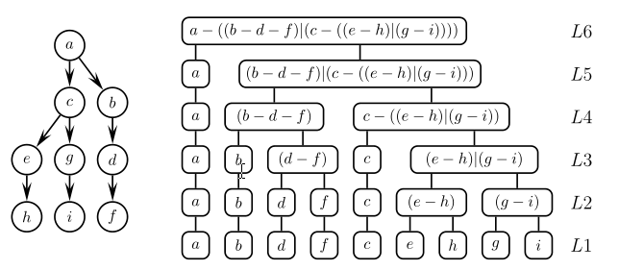
6
THEOREM
The conserved quantities of a causal set are scale-free
hierarchical networks of group-theoretical block systems
over the causal set.
Compression takes place

Slide 7
7
THERMODYNAMICS
Minimizing the action also minimizes free energy and entropy.
Least-entropy is least uncertainty in the system.
Remaining trajectories correspond to remaining uncertainty.
The block systems are invariant under remaining trajectories.
The block systems are certain.
The networks are also certain.
They are the conserved quantities.
Compression takes place.

Slide 8
8
/////////////////////////////////////////////////////////////////////////////////////////////////////////////////////////////////////////
observation
Neuro-
science
Bio-
physics
Evolution
Artificial
intelligence
Computer
engineering
Physics
verification
TOP – DOWN
Fuster
Cuntz
Friston
Lin
Eagleman
Susanne Still
Gavin Crooks
(motor
proteins)
Lerner
Kauffman
DNA
Hawkins
George
(Numenta)
Natural
languages
Google
patents
OO A&D
T. Pernu
A. Annila
T. Hartonen
heuristic
theory
Scale-free hierarchical networks of blocks
action, entropy
MOVEMENT?
Scale-free hierarchical networks of blocks
causal sets, action functional, entropy
prediction
BOTTOM - UP
Causal set model – mathematical properties
action functional
➔
Theory of complex systems with a detailed dynamics
Fundamental principles of Physics
causality, symmetry, least-action, energy/entropy
////////////////////////////////////////////////////////////////////////////////////////////////////////////////////////////////////////////

Slide 9
9
Sergio@SciControls.com
www.SciControls.com
Complexity 17(2): 19–38 (Nov. 2011)
Thanks!

