Slide 1
Adaptive Systems and Analyst-independent technologies
Sergio Pissanetzky
2010
Notes:
Title

Slide 2
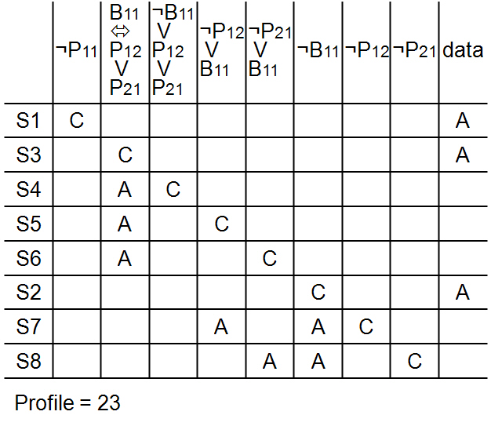

Slide 3
MATHEMATICS
set + partial order → structure
set + partial order + dissipative dynamics → emergence
the dissipative dynamics minimizes resources
and generates the emergent structures
structure is in the information!
structure is not the result of complexity!

Slide 4
WHAT IS EMERGENCE?
ideas
art
culture
emotions
conclusions
computer bugs
weather
psychology
markets
theories
language
this list
genetic codes
life forms
crystals
organs
internet
engineering
Why so much emergence?
Emergence is caused by sets, sets are everywhere!
Emergence is the most fundamental principle in the universe!

Slide 5
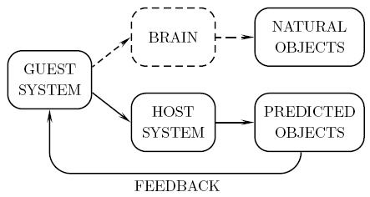
EXPERIMENT
BRAIN
NATURAL STRUCTURE
INFORMATION
ALGORITHM
PREDICTED STRUCTURE
FEEDBACK

Slide 6
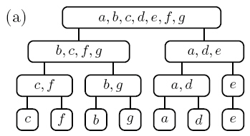

Slide 7
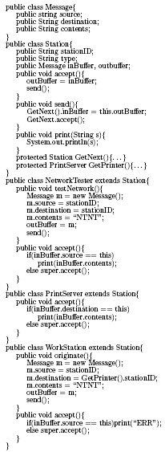
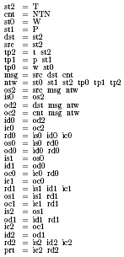
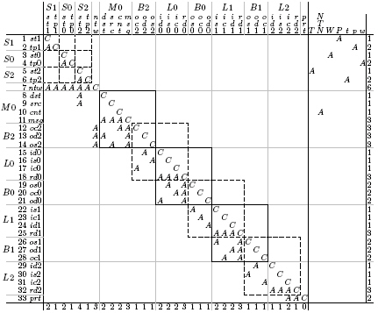

Slide 8
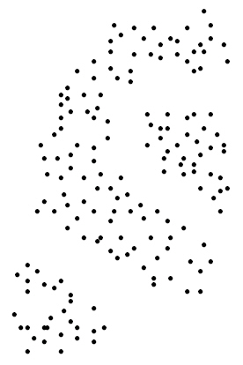

Slide 9
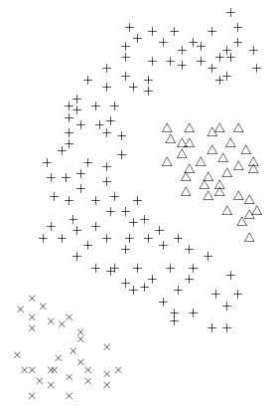

Slide 10
INTELLIGENCE
information + emergence → intelligence
process of generating emergence → understanding
reuse of emergence → feedback
structure encapsulates information and behavior
intelligence is the ability to solve problems
structure solves problems
complexity ≠ intelligence
gigantic brain simulations ≠ intelligence
instead, bugs will emerge

Slide 11
S.Pissanetzky. Coupled dynamics in host-guest complex systems duplicates emergent behavior in the brain. WASET Proc., Vol. 69, pp. 927-935 (August 2010).
Sergio@SciControls.com

