Slide 1
1
Automation, robotics, brains,
and a new theory of Physics
Sergio Pissanetzky
Sergio@SciControls.com
Notes:
Title

Slide 2
2
Complex systems with a detailed dynamics
Too detailed for Statistical Mechanics or non-linear Dynamics.
Examples:
-- adaptive systems: brain, organisms, organs, species.
-- robots, computers.

Slide 3

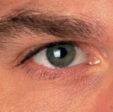



3
mother!
adaptive
system
mother!
?

Slide 4
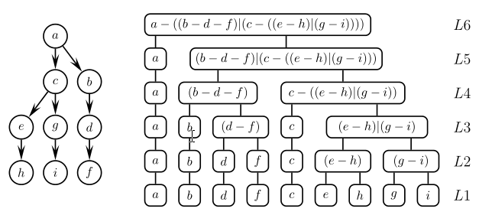
scale-free hierarchical network
4

Slide 5
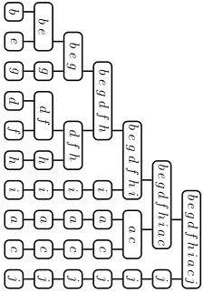
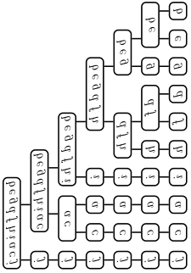
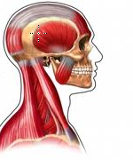
5
mother!
mother

Slide 6
6
Central Theorem
Any dynamical system has a scale-free hierarchical network of group-theoretical block systems that represents an invariant behavior of the system.

Slide 7
7
Scale-free hierarchical networks of information
uncertainty, prediction, entropy, granularity
prediction
BOTTOM - UP
Action functional
Causal set model – mathematical properties
Theory of Causal Dynamical Systems
complex systems with detailed dynamics, such as adaptive systems
Fundamental principles of Physics
causality, symmetry, least-action, energy/entropy
////////////////////////////////////////////////////////////////////////////////////////////////////////////////////////////////////////////

Slide 8
8
/////////////////////////////////////////////////////////////////////////////////////////////////////////////////////////////////////////
observation
Neuro-
science
Bio-
physics
Evolution
Artificial
intelligence
Computer
engineering
Physics
verification
TOP – DOWN
Fuster
Cuntz
Friston
Lin
Eagleman
Still
(motor –
proteins)
Lerner
Kauffman
DNA
Hawkins
George
(Numenta)
Natural
languages
Google
patents
OO A&D
Shih
Tsallis
Pernu-Annila
heuristic
theory
Scale-free hierarchical networks of information
uncertainty, prediction, entropy, granularity
MOVEMENT?
Scale-free hierarchical networks of information
uncertainty, prediction, entropy, granularity
prediction
BOTTOM - UP
Action functional
Causal set model – mathematical properties
Theory of Causal Dynamical Systems
complex systems with detailed dynamics, such as adaptive systems
Fundamental principles of Physics
causality, symmetry, least-action, energy/entropy
////////////////////////////////////////////////////////////////////////////////////////////////////////////////////////////////////////////

