Slide 1
Symmetry, structure, and causets in discrete quantum gravity
Sergio Pissanetzky - 2012
APS San Angelo – March 2012

Slide 2
2. Causet
S = {a, b, c, d, e, f, g}
ω = {a<b, a<e, b<c, c<d, e<f, e<g}

Slide 3
3. Modeling physical systems
Newton’s second law.
S = {a, b, c, d, e, f, g, h, i, j, k, l, m, n, o, p, q, r} (18)
ω = {a<p, b<l, c<p, d<o, e<n, f<n, g<j, h<k, i<k, k<m, n<r, p<q} (12)
Euler equations for the rigid body.
S = {a, b, c, d, e, f, g, h, i, j, k, l, m, n, o, p, q, r, s, t, u} (21)
ω = {d<g, e<h, f<i, g<j, h<k, i<l, j<m, k<n, e<o, a<p, m<p, b<q, n<q, c<r,
o<r, p<s, q<t, r<u} (18)
Java program (13 classes, 114 lines of code).
S = {a, b, c, d, e, f, g, h, i, j, k, l, m, n, o, p, q, r, s, t, u, v, w, x, y, z, A, B, C,
D, E, F, G} (33)
ω = {a<e, a<f, a<g, a<k, b<j, b<o, c<i, c<k, d<h, d<k, e<j, e<n, f<j, f<l, g<k,
h<k, i<k, j<l, j<n, j<o, k<l, k<n, k<o, l<m, m<r, m<s, n<p, o<q, p<r, p<s,
q<r, q<w, r<s, r<t, r<w, s<u, t<v, u<y, u<z, v<y, v<C, w<x, x<y, x<A,
y<z, y<A, y<C, z<B, A<D, B<F, C<E, D<F, D<G, E<F, F<G} (55)

Slide 4
4. Causet Symmetry
S = {a, b, c, d, e, f, g}
(a, b, c, d, e, f, g)
(a, e, b, g, f, c, d)
(a, b, e, f, g, c, d)
(a, e, f, b, c, d, g)
( ... )

Slide 5
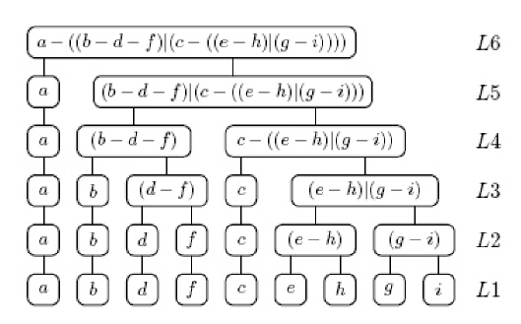
5. A hierarchy of block systems

Slide 6
6. Causet Functional
S = {a, b, c, d, e, f, g}
ω = {a<b, a<e, b<c, c<d, e<f, e<g}
(a b c d e f g)
a<b
a < e
functional = 2 Σ (costs) = 20

Slide 7
7. Causet dynamics
a b c d
e f
g

